Slide 1
Platform Engineer’s Journey
Yasmeen Alufaisn, PhD

Slide 2

Disclaimer
The views and opinions contained in this presentation are those of the presenter. Any mentioned products should not be interpreted as endorsement or recommendation by Saudi Aramco.
The ideas and the work presented here are a collective of a teamwork that I am grateful for.
Acknowledgment

Slide 3
About Myself
2018
2018 - 2019
2019 - Present
PhD in Computer Science from University of Texas at Dallas
Assistant Professor at Prince Mohammed Bin Fahad University (PMU), Saudi Arabia
“In 2018 37.600 Students earned a STEM major, 58% of which were female students. While the most preferred STEM majors of female students are Communication and Information Technology 34.1% …”
https://www.stats.gov.sa
Title –Livvic -24
Body - Catamaran Light 12
Body –Calibri 12

Slide 4
About Myself
2018
2018 - 2019
2019 - Present
PhD in Computer Science from University of Texas at Dallas
Assistant Professor at Prince Mohammed Bin Fahad University (PMU), Saudi Arabia
Cloud Engineer at Saudi Aramco
Analytics Infrastructure Support
High Performance Computing Support
Database Services Support
Cloud Services Support
Title –Livvic -24
Body - Catamaran Light 12
Body –Calibri 12

Slide 5
Table of Contents
01
History
02
Environment
03
Platform Status
04
Challenges
Title –Livvic -24
Body - Catamaran Light 12
Body –Calibri 12
05
Future

Slide 6
01
History
Title –Livvic -24
Body - Catamaran Light 12
Body –Calibri 12

Slide 7


How We Started
2016-2017
Docker workshops
Exploring IaaS, PaaS, SaaS
Traditional Applications
On-premise Environment

Slide 8



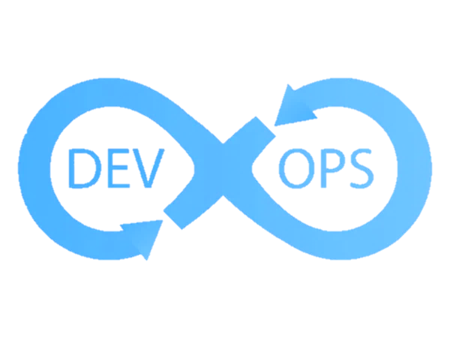
Goals
2018
OpenShift and other solutions POC
Containers adoption
Host MLDL and IR4.0 workloads
Enable DevOps and agile software delivery practices
On-premise
Notes:
Enable application modernization via adoption containers and its ecosystem.
Basically looking for PaaS based on containers that can Host MLDL and IR4.0 workloads
Enable DevOps and Agile software delivery practices and with DX, CI/CD, self-service to other teams.
A tricky part is that we wanted a solution that does all of that on-prem.
As we went along on our journey a lot changed. as we will see along the story.

Slide 9

Challenges
2018
OpenShift and other solutions POC
Focus on DX
Title –Livvic -24
Body - Catamaran Light 12
Body –Calibri 12
Most Solutions
Enterprise Security
On-premise
Notes:
During this phase, we realized that not all solutions can achieve our goals as many of them were not focused on Dev Exp. They don’t meet enterprise Security requirement which is a top priority for us. And last but not least they were not on-prem

Slide 10

Disconnect/Restricted
Only approved access to limited set of URLs for downloads
No access to public source code repos including GitHub
2018
OpenShift and other solutions POC
Issues difficult to solve within deadline
Internal registry for developers
Containers Adoption
Host MLDL and IR4.0 workloads
Notes:
By default, all is blocked. To access anything, you need to request approval.
So what do we do when we cannot approve a URL? Either mirroring the registry or offline downloads and move it to our environment.
when images get updated. We have to keep an eye on the updates and repeat the process.
To put an icing on the cake, network is controlled by another group which made it even more difficult.
Because of this and other security restrictions that we have in our environment, some vendors or their consultants have difficulty solving issues within the deadlines given.
consultant can deploy in 10 mins to 4 months.

Slide 11

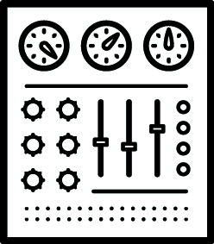



OpenShift Adoption
On-premise
Easier infrastructure requirements
Abstraction
Smooth life cycle management
Professional support program
Holistic enterprise training
2019-Present
OpenShift Pilot
Notes:
e.g. network requirements were easy met.
So int the time period 2019-presnet we are in a Pilot stage with OpenShift, hosting a few production applications, rethinking architecture and expansions.
The solutions showed a potential for more than what was initially planned
Many IR4.0 projects and technologies benefit tremendously from the capabilities of platform as a service

Slide 12
02
Environment
Title –Livvic -24
Body - Catamaran Light 12
Body –Calibri 12

Slide 13

Traditional Oil & Gas Enterprise
Many Silos
Customers
Title –Livvic -24
Body - Catamaran Light 12
Body –Calibri 12
Team

Slide 14
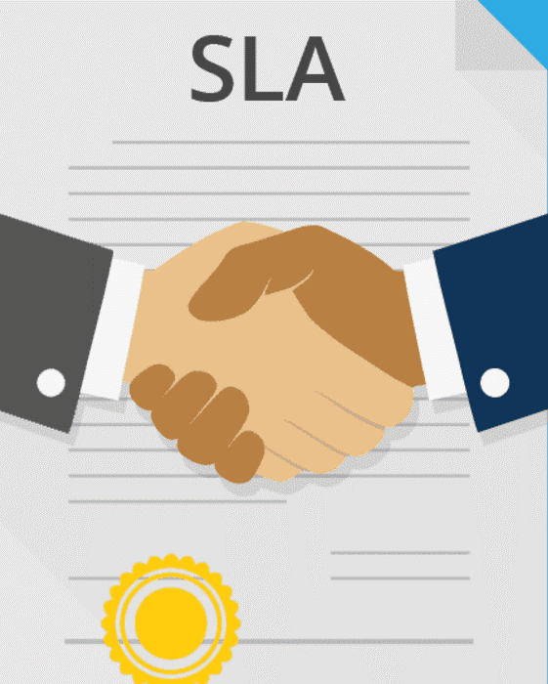
Solution Description
Operational Requirements
Customers
Support Model
FAQ
Title –Livvic -24
Body - Catamaran Light 14
Body –Calibri 12

Slide 15
Operational Requirements
Software/container images should be covered by project security review​
Deployment recommendation: operators, or Helm charts
Containers should not assume or require elevated privileges to run
Containers need to pass at least latest Clair’s/Anchore container security vulnerability scans
Base image used should be based on Red Hat UBI
Containers stdout, console messages and logs should not expose sensitive data (e.g. connection passwords, secrets, keys,..etc.)
Customers
Title –Livvic -24
Body - Catamaran Light 14
Body –Calibri 12

Slide 16
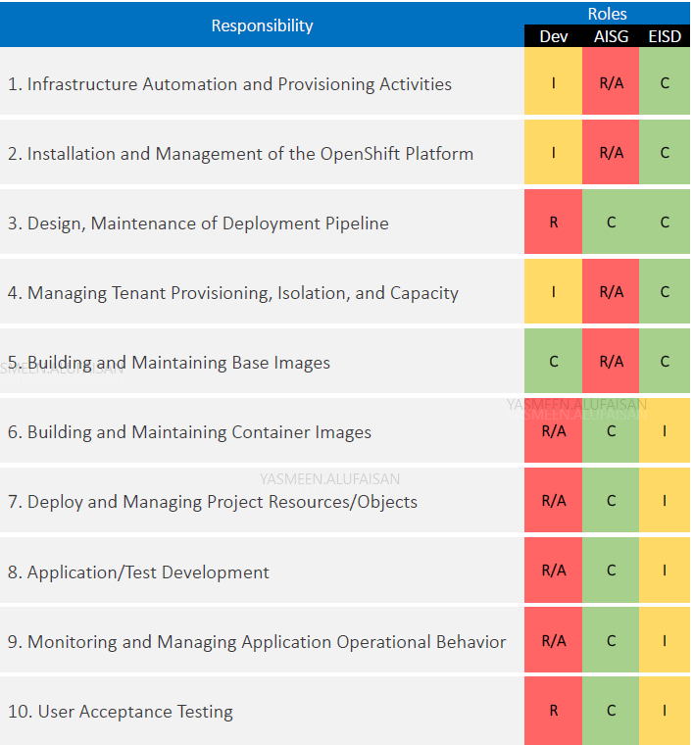
Dev Op Sec
Responsible (R)
Accountable (A)
Consulted (C)
Customers
Informed (I)
RACI
Red Hat Consulting DevOps and OpenShift Playbooks
Customized to our needs
Title –Livvic -24
Body - Catamaran Light 12
Body –Calibri 12
Notes:
Having this document, agreed on and signed by every project owner save us time an effort by avoiding many calls and emails between us and the developers.

Slide 17


Minimize Handoffs Between Teams
Within-team controlled:
Storage
Network
Monitoring & logging
VMware vRealize Suite
- vRealize logs
- VRealize Operations
Community custom Grafana operator
Team
Analytics Support
Server Support
Cloud Support
Title –Livvic -24
Body - Catamaran Light 12
Body –Calibri 12
Notes:
ease the communication among us and We try not to cross teams if possible. At the time of the openshift adoption, we had VMWare as our private cloud in production that I will go over in the next slide.
Two groups => inconvenience and delays as different groups led by different people with different priorities.
Merge =>unified the efforts in supporting openshift layer along with its underlying network and storage. Things became so much easier going forward as we minimized the had-offs between different teams.
Now we have a Platform teams that are required enough expertise in storage, network.

Slide 18
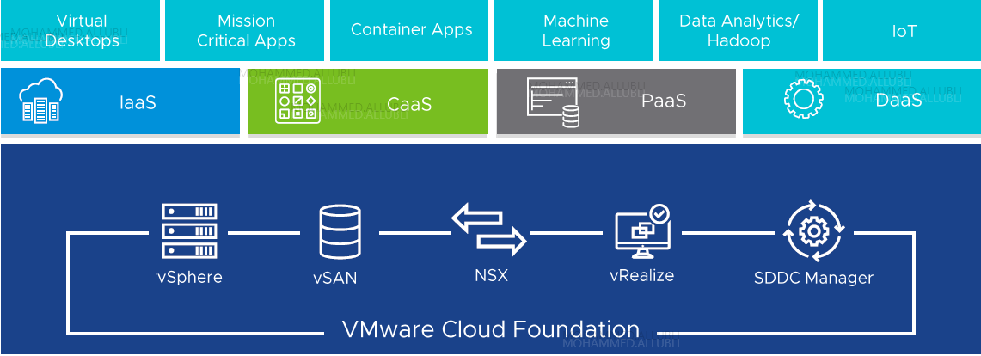
Cloud Environment
Private Cloud - VMware Cloud Foundation (VCF)
VMware CSI Storage
Hyper-converged Infrastructure (HCI)
- Unified system with storage, compute, network technologies with integrated management.
NSX-T New Load Balancer AVI
Highly available load balancer
Smooth Migration
Costly
Title –Livvic -24
Body - Catamaran Light 12
Body –Calibri 12
Finite Resources
Extra Layer of Complexity
Notes:
Vmware Cloud Foundation (VCF) as our private cloud with the full stack (HCI) technology.
The deployment of PaaS on top of VCF included integrations with multiple layers and great advantages where we have vSphere for hosting infrastructure,
VMware CSI from VMWare HCI vSAN as our storage
NSX-T for network load balancing and security where the new Load Balancer AVI can provide global load balancing functionality between clusters making applications highly resilient across clusters so we can achieve application mobility and migration
Disadvantages: It is more expensive than public cloud, we have finite resources that is limited to what we have and based on capacity planning, and last but not least, it adds an extra layer and complex infrastructure to manage
(Install on VMWare vs bare-metal (Document)?)

Slide 19

Extra Layer of Complexity
The day all the images disappeared
Notes:
Now that we manage all layers such as storage, network, servers. Things get complex. So on one day, let’s call it the day all the images disappeared, a cluster in VMWare was shut down ungracefully due to a network change, luckly it was not a production cluster. The team spent some time to have openshift VMs back and running. But remember here, the worker nodes have CoreOS that is immutable, so what happened is the worker nodes noticed a data glitch and then it deleted all the images. Kubelet then kept trying to fetch the images but again this is a restricted environment. So how can we get the images? Through a proxy node that had the HAProxy down. So you see all the complication that need to be delt with by a single team.

Slide 20
Extra Layer of Complexity
Lessons learned
Regular backup
Knowledge sharing
Graceful shutdown
The day all the images disappeared
Notes:
Establish and update container registries images close to the cluster (e.g bastion nodes)
Take ETCD backup before you shut down cluster gracefully

Slide 21
Migration Experience
OpenShift v3 to v4
No workload
Developers copied their manifests and data on NFS
Hyper-v to Vmware
Flexibility and availability
Latency is less than 2 milliseconds for datacenters that are ~ 10 km apart

Slide 22
03
Platform Status
Title –Livvic -24
Body - Catamaran Light 12
Body –Calibri 12

Slide 23



Setup
General-purpose (multi-tenancy)
Specific-purpose
Operational/Test
Control-plane Nodes
Control-plane Nodes
Control-plane Nodes
Bastion Node
(proxy)
Bastion Node
(proxy)
Bastion Node
(proxy)
Worker/Infra Nodes
Worker/Infra Nodes
Worker/Infra Nodes

Slide 24
Projects Onboarding
Types
Access
Tracking
Restrictions
In-house
Commercial
AD Authentication
RBACs Authorization
Project admin responsible for adding team-members/roles
Project metadata as annotations/labels
Project naming conventions “dept-project-SDLC stage”
Disabled self-provisioning
Enforced quota/limit
Routes only
Notes:
disable self provisioning projects for now expect for terminal/code ready workspace

Slide 25






Projects Onboarding
1
2
3
4
Request access
Review
Fill and sign a form
Provision a project using script/template

Slide 26

Support
TAM
Workshops
Weekly discussions
Focuses support tickets and remote access/shadowing when possible

Slide 27

Cluster Update
Technology still evolving
Frequent updates
Seen improvements
Faced issues:
Networking
HW version
Notes:
Worker node did not update due to networking issues
. we saw bugs redhat did not see (twice). When update, we broke the cluster
Captured by redhat insight team That is why they are testing on VMWare hardware versions

Slide 28
04
Challenges
Title –Livvic -24
Body - Catamaran Light 12
Body –Calibri 12
Notes:
The journey is Challenging, being on-prem with new data governance, residency, and many security constraints is a bit hard. But we are doing our best to resolve the challenges faced by both ops and devs. I will share with you some of the challenges we faces and how we resolved them.

Slide 29

Challenge
Resolution
Different operational model
& steep learning curve
Official training
- Developer path - Admin path
- Business leader path
Enterprise architecture day
- Listen to the customers
Biweekly office hours
- interactive discussions, news, informal format for support, brainstorming
Would like to see:
Populating images internally => Nexus\
RWX NFS ( issues NFS for development ) manual provisionin Recycle, deprecated but works, it deletes the data unless overridden in the API server
GPU operator
Some solutions not HTTP/HTTPS
Monitoring vendor
Podman, skopeo
Notes:
Different operational model which means, issues are most likely new
, and a steep learning curve, it requires a culture change.

Slide 30
Challenge
Resolution
Metrics to monitor active projects
- Annual one-to-one meeting with users to discuss their experience, challenges, requests
Site Reliability Engineering (SRE)
Stale Projects
Populating images internally => Nexus\
RWX NFS ( issues NFS for development ) manual provisionin Recycle, deprecated but works, it deletes the data unless overridden in the API server
GPU operator
Some solutions not HTTP/HTTPS
Monitoring vendor
Podman, skopeo
Notes:
some metrics that can determine the project is actively serving
Encourage having an SRE role, where we can have sli and slo for monitoring

Slide 31
Challenge
Resolution
Skopeo instead of Podman
Nexus hosted and proxied container registries
Some public registry repos are enabled in the OpenShift access list such as RedHat OpenShift registry
Images
Podman requires sudo privileges
And once more, disconnected/restricted
Populating images internally => Nexus\
RWX NFS ( issues NFS for development ) manual provisionin Recycle, deprecated but works, it deletes the data unless overridden in the API server
GPU operator
Some solutions not HTTP/HTTPS
Monitoring vendor
Podman, skopeo
Notes:
Future we have plans to test again the Quay bridge operator and how we can use Quay organizations and decentralize the governance to the users responsibilities

Slide 32
Challenge
Resolution
GPU operator
Issues with entitlement
CoreOS is not registered with satellite
HW incompatibility issue
Tricks and hops to get the entitlement
Version 4.8 removed this requirements with the OpenShift Driver Toolkit
Populating images internally => Nexus\
RWX NFS ( issues NFS for development ) manual provisionin Recycle, deprecated but works, it deletes the data unless overridden in the API server
GPU operator
Some solutions not HTTP/HTTPS
Monitoring vendor
Podman, skopeo
Notes:
and since you have OpenShift they assume you have the entitlement.
Thanks to the OpenShift Driver Toolkit, there is a container image built with all the packages required to build kernel drivers
, we've been able to remove the need for accessing the Red Hat RHEL repository servers to deploy the NVIDIA GPU Operator. The dependency on a valid RHEL subscription certificate, plus the need to access packages from Red Hat servers, were major burdens for the NVIDIA GPU Operator users.
In this new release, the operator now relies on an OpenShift core image to build the GPU driver. The removal of the access to the package servers also simplifies the accelerator-enablement in disconnected environments (proxy, disconnected, and air-gapped), as customers will not have to configure the access to the package server mirrors anymore.

Slide 33
Challenge
Resolution
Manually creating the PVs
Developers requesting RWX to NFS and dynamic provisioning create a new volume
Populating images internally => Nexus\
RWX NFS ( issues NFS for development ) manual provisionin Recycle, deprecated but works, it deletes the data unless overridden in the API server
GPU operator
Some solutions not HTTP/HTTPS
Monitoring vendor
Podman, skopeo

Slide 34
Challenge
Resolution
CodeReady
More empowerment and support
The future direction of RedHat on this by moving it to the community?
Snowflakes of many inconsistent development environments, which causes difficulty in the support
Would like to see:
Populating images internally => Nexus\
RWX NFS ( issues NFS for development ) manual provisionin Recycle, deprecated but works, it deletes the data unless overridden in the API server
GPU operator
Some solutions not HTTP/HTTPS
Monitoring vendor
Podman, skopeo
Notes:
Challenge: developers want something more they can control, on their desktop
CodeReady
More empowerment and support for the CodReady project, something similar to gitpod/Coder, not sure what is the future direction of RedHat on this by moving it to the community
https://developers.redhat.com/articles/2022/04/18/announcement-red-hat-codeready-studio-reaches-end-life
Red Hat CodeReady Studio will reach the end of life on April 19, 2022. The project is transitioning to community development and support as part of the JBoss Tools project.

Slide 35
05
Future
Title –Livvic -24
Body - Catamaran Light 12
Body –Calibri 12

Slide 36








To-do List
Timed evaluation projects
Assign priorities to projects
Auto scaler
Monitor user/vendor activities
GitLab - Wiki, CI/CD
Different OpenShift subscriptions
Non-OpenShift clusters workflow e.g., Tanzu
Separate OpenShift workload on the cloud
Notes:
Timed evaluation projects to seperate Planned vs. non-planned deployment. Non-planned that can be created automatically without approvals with standard resources. And planned Planned have a better SLA and guaranteed resources (minimum requests) operator for creating workspace but we need more than that to capture projects’ metadata
Priority: control the scheduling of pods. Evict it higher priory request. Priority Class name. platinum/gold/silver/etc SLAs enforce priority class name.
Auto scalar because developers overestimate the resources or don’t know how to set them to begin with. VPA (vertical pod autoscaler) and Goldilock
Monitoring: SCC, Node ports by creating policies by using Utilize Policy engine such as OPA, or maybe run a cronjob or something that collects non restricted scc and watch for privileged or custom ones, any other scc that is used other than restricted is not default, Utilize Policy engine: Open Policy Agent OPA/Keyverno. (vendor RBAC requesting read to secret objects (All projects) # could be caught by a policy engine)
GitLab
Standard subscriptions where you do not need premium support. subscription, or OKD for longer duration environments Use OCE Openshift container Platform engine where PaaS is not needed e.g. hosting applications SO Tiers of clusters for cost optimization: . OKD opensource sister project. Issues sometime advances, sometimes it is behind
Non-Openshift clusters workflow e.g. TANZU in conjunction with openshift for cost-saving and good Cluster Life Cycle Management
Separate openshift workload on the cloud. As you saw previously from the structure of VCF, both PaaS and IaaS has the same access. And that is something that we want to avoid.

Slide 37

THANKS
Does anyone have any questions?
yalufaisan@gmail.com

Slide 38
References
http://v1.uncontained.io/playbooks/fundamentals/openshift_roles_responsibilities.html
https://cloud.google.com/blog/products/devops-sre/sre-fundamentals-slis-slas-and-slos
https://cloud.netapp.com/blog/kubernetes-nfs-two-quick-tutorials-cvo-blg
https://www.vmware.com/mena/products/cloud-foundation.html
https://cloud.redhat.com/blog/entitlement-free-deployment-of-the-nvidia-gpu-operator-on-openshift
https://www.statista.com/statistics/1119547/saudi-arabia-gender-breakdown-stem-by-major
https://www.stats.gov.sa/sites/default/files/woman_international_day_2020EN.pdf

Slide 39
CREDITS
Presentation template by Slidesgo
Icons by Flaticon
Infographics by Freepik
Images created by Freepik

